Slide 1


Fast Competitive PID Line-Following Robot
Component Selection & System Design

Slide 2
Objective:
Goal: Build a fast, accurate PID-based line-following robot
Focus: Selecting top components for peak performance

Slide 3
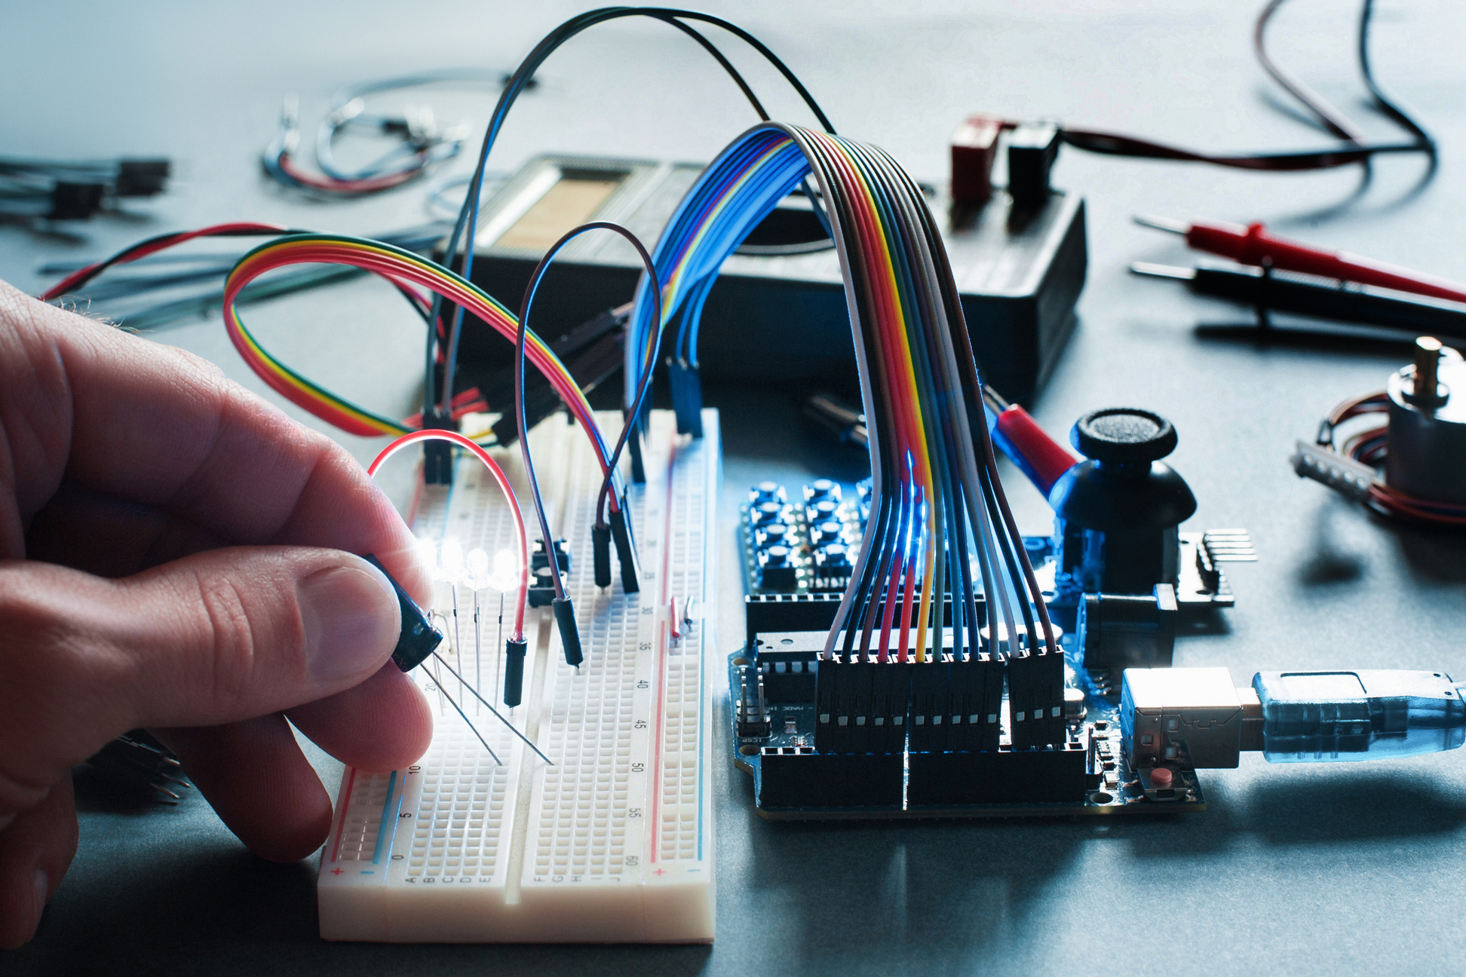
Component Categories
We chose 1 ideal component for each of these:
Microcontroller
Motors
Motor Driver
Line Sensor

Slide 4
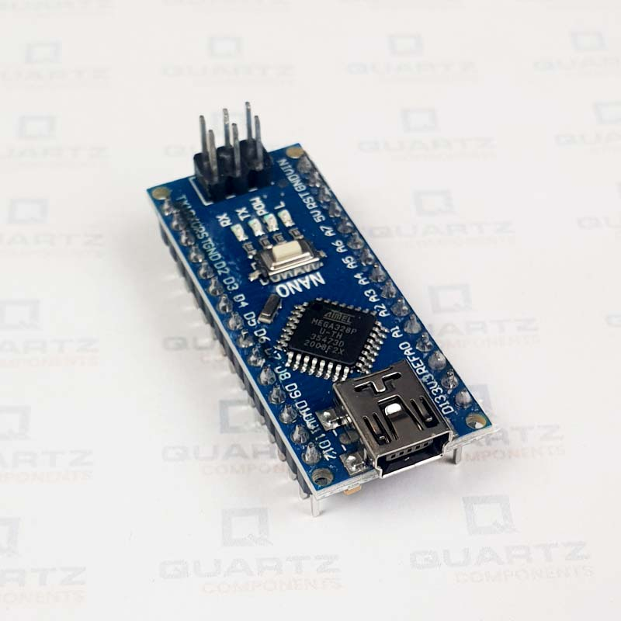
Microcontroller - Arduino Nano
1
Affordable and compact
2
Easy to program with Arduino IDE
3
16 MHz clock speed – sufficient for basic PID control
4
✅ Best choice for beginner-friendly, reliable PID logic

Slide 5
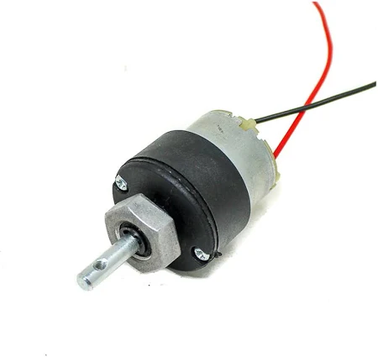
Motor - 300 RPM DC Geared Motors
300 RPM = good balance between speed & torque
12V operation = higher performance
Sturdy for sustained motion
✅ Ideal for line-following with quick turns and acceleration

Slide 6
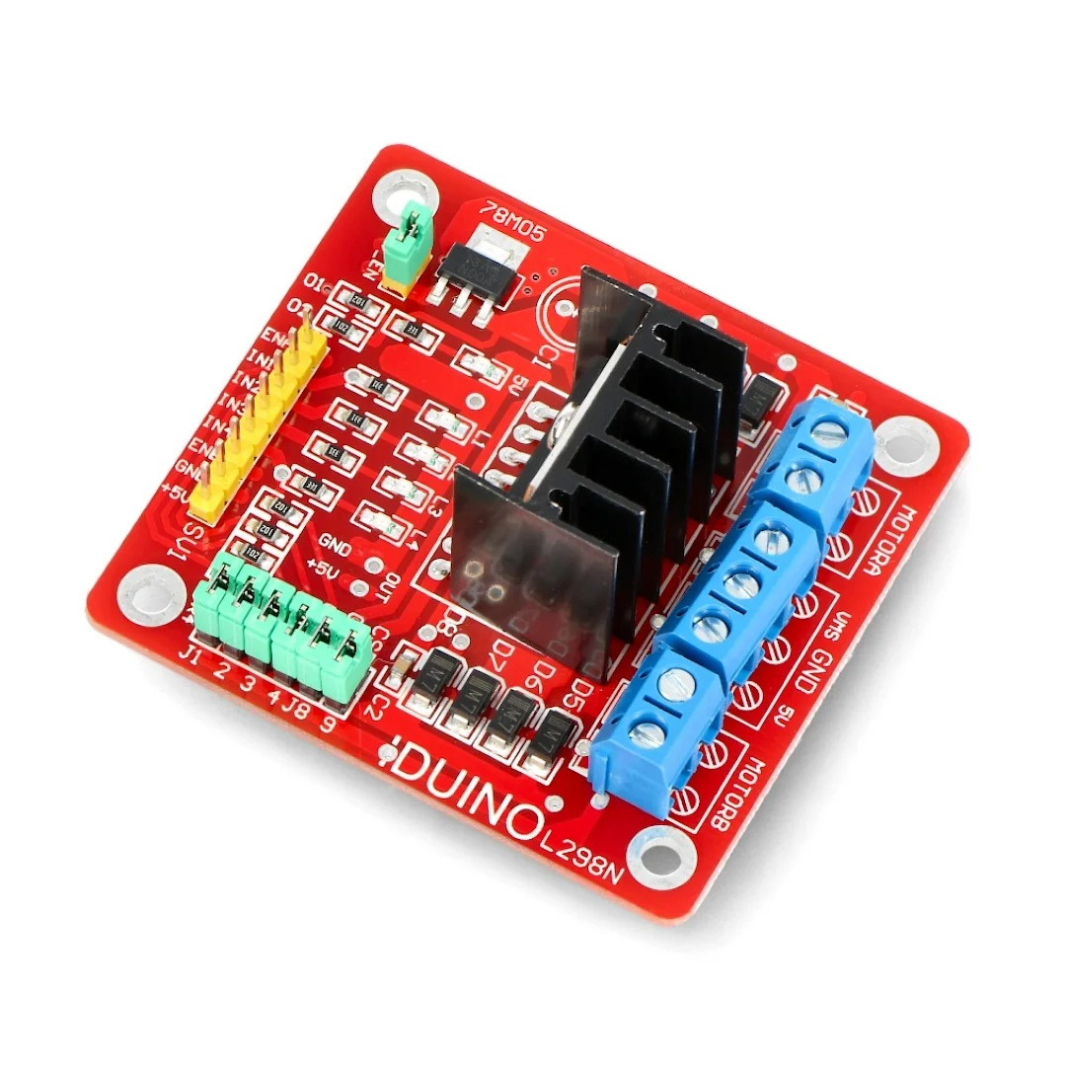
Motor Driver - L298N Dual H-Bridge Motor Driver
• Dual H-Bridge supports 2 motors
• Handles 12V and up to 2A current
• Compatible with Arduino Nano
• Reliable and beginner-friendly motor control

Slide 7
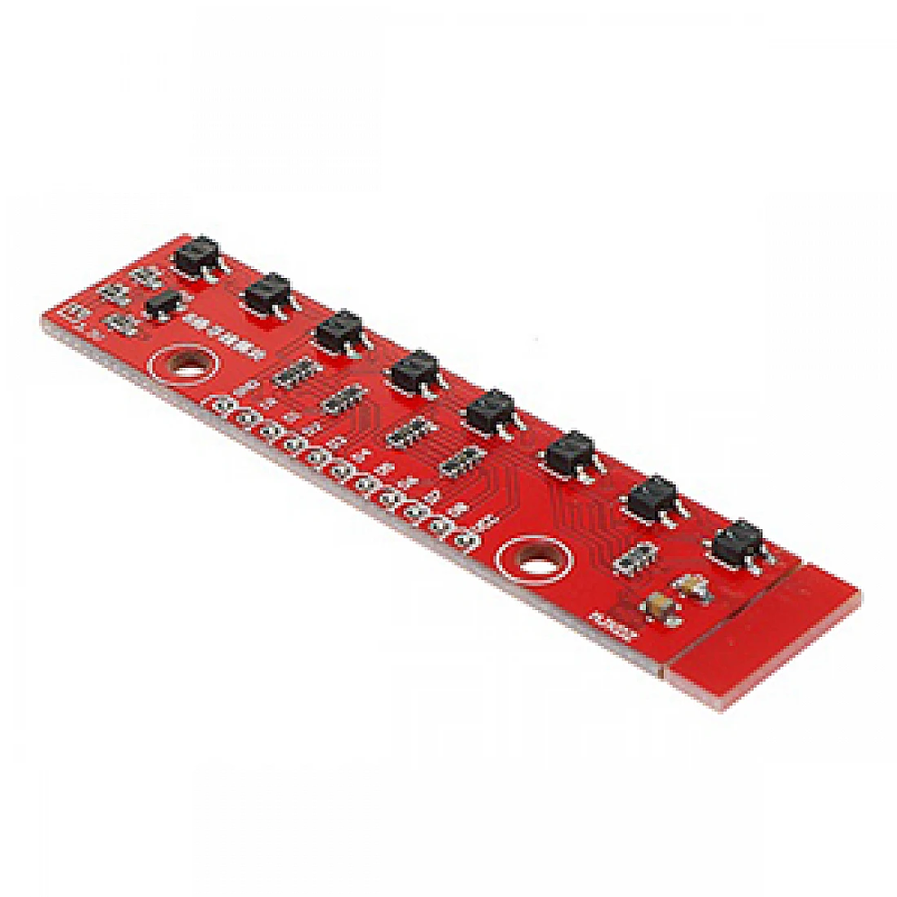
Line Sensor - QTR-8RC Reflectance Sensor Array
8-channel infrared reflectance sensor array
Designed to detect lines on a surface (black vs. white)
Outputs digital (RC timing) signals for fast response
Ideal for PID: precise detection of robot’s position relative to the line.
Works perfectly with Arduino Nano

Slide 8

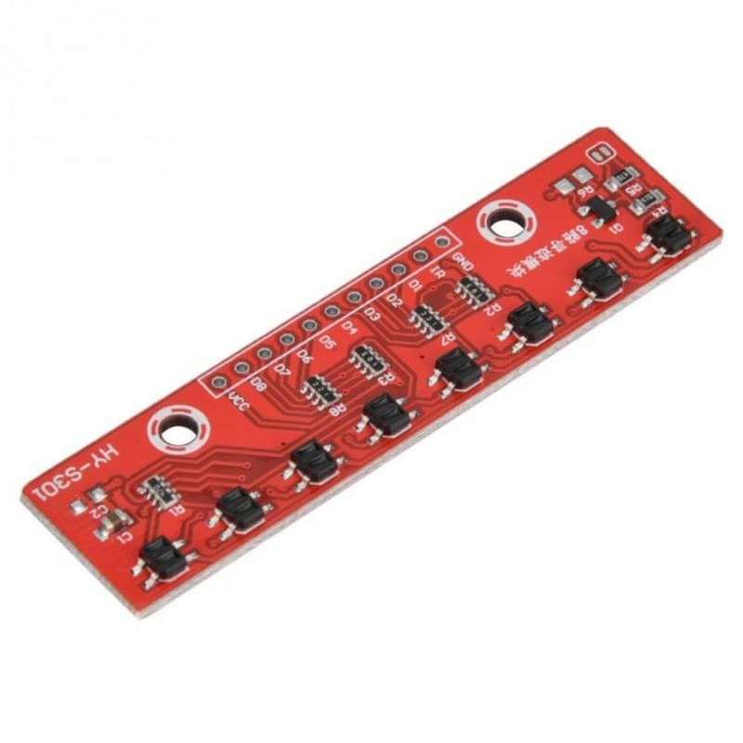
🔧 Why It’s the Best Choice:
✅ High accuracy for smooth curves and fast speed
✅ Fast response for real-time PID correction
✅ Widely used in competitions – proven reliability
✅ Compatible with digital pins – no need for ADC

